Slide 1
Fall 2021 Pre-calculus
Lesson 8.3
Dr. O’Brien
Lehman High School
November 10, 2021
Notes:
Quadratic formula

Slide 2
Today’s activity: self-assessment
be sure to: find seat. Get out your binder and carefully read the instructions below. Then complete the self-assessment activity.
Today you’ll be finishing the review pset and self-assessing:
For each problem you finish, check the answer. Then fill out your answer record in the appropriate spot.
Feel free to work with your neighbor on the review pset.
Make a real effort to try each problem on your own before checking your answer!
Quadratic formula:
For any quadratic $ax^{2}+bx+c=0$ you can find the roots x using the quadratic formula:
$$x=\frac{-b±\sqrt{b^{2}-4ac}}{2a}$$
Notes:
See answer keys. When students finish check answer record and give them extra pset.
This activity targets review for examine and meta cognitive thinking about thinking.
+HDW compute the composition of two functions? It’s substitution of on function into the x value of another.
+how do I find the domain? You want to figure out which x values are not allowed. If you have a fraction think about what x values would make the denominator equal 0, for square root think about what will make the expression inside it less than zero.
+How do you treat negative coefficients? remember to include the ‘-‘ when you plug the value into your formula
How are the answers from (3-6) useful for sketching the graph of these functions? They tell us what the x-intercepts are.
How do I find the vertex? convert to vertex form: (x +a)^2 + b, then vertex is (a,b).
How could I check my work for (3)? plug in the values of x and see if it gets you 0. You could also use another method to calculate roots, such as completing the square.

Slide 3
Exam next early next week!
We’ll review the rest of the week
Topics to be covered:
Combining functions
arithmetic combinations
composition of functions
Polynomials:
Applying leading coefficient test,
finding roots,
and sketching quadratics and higher order polynomials
long division of polynomials

Slide 4
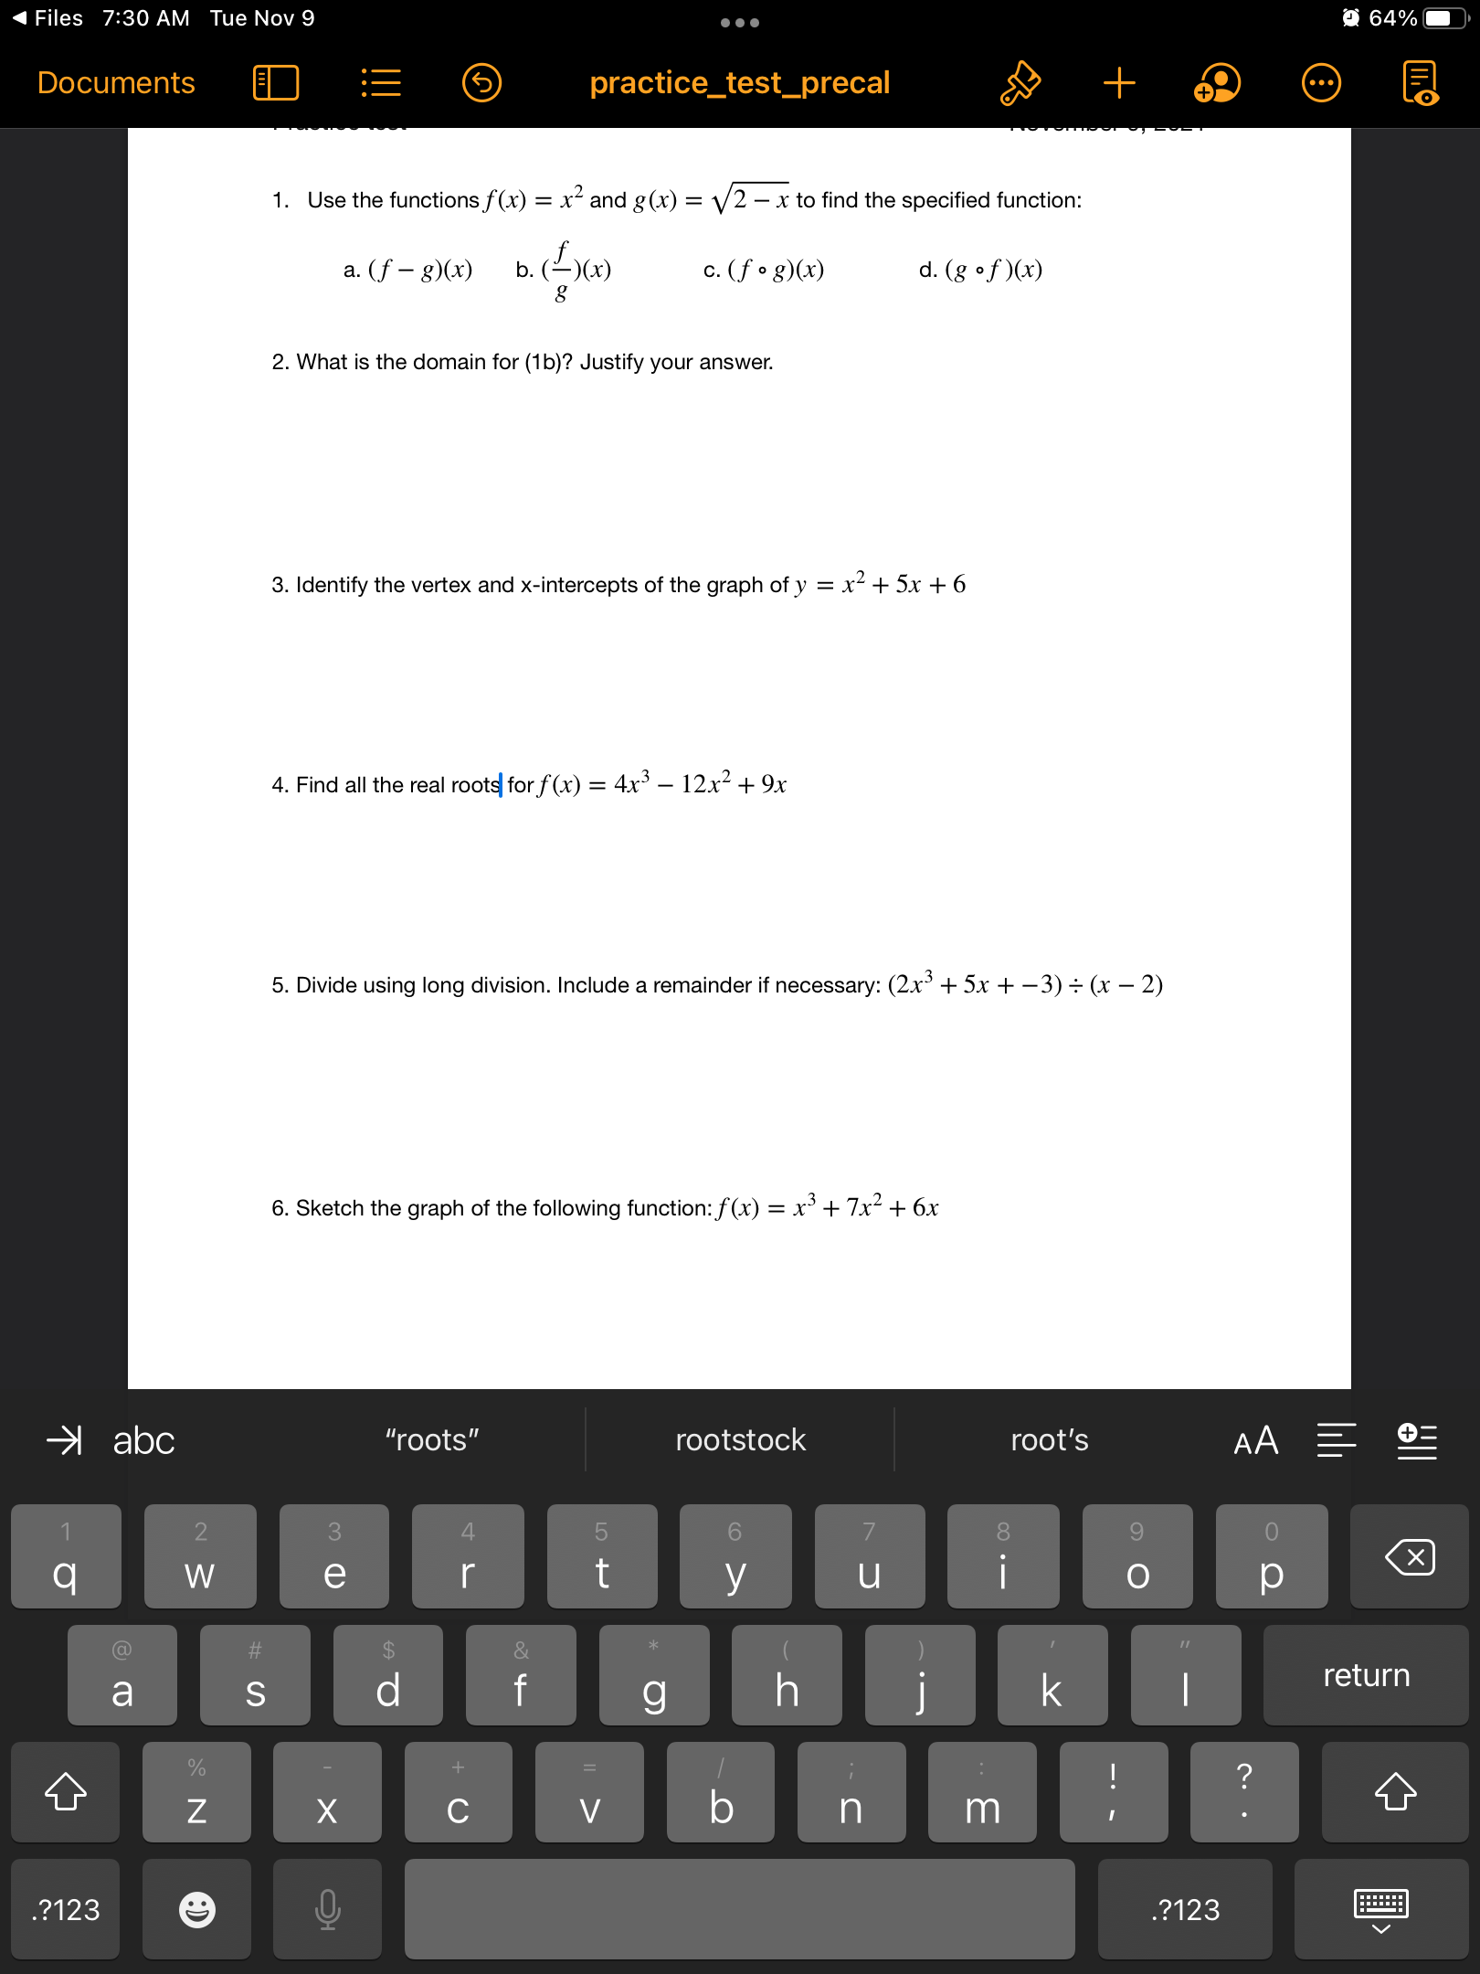
Partner work
be sure to: Work with a partner on each problem. After finishing a section, ask Dr. O’Brien to review your answers. Be prepared to turn in one of your assignments (with both names on it).
Notes:
See answer keys.
+HDW compute the composition of two functions? It’s substitution of on function into the x value of another.
+how do I find the domain? You want to figure out which x values are not allowed. If you have a fraction think about what x values would make the denominator equal 0, for square root think about what will make the expression inside it less than zero.
+How do you treat negative coefficients? remember to include the ‘-‘ when you plug the value into your formula
How are the answers from (3-6) useful for sketching the graph of these functions? They tell us what the x-intercepts are.
How do I find the vertex? convert to vertex form: (x +a)^2 + b, then vertex is (a,b).
How could I check my work for (3)? plug in the values of x and see if it gets you 0. You could also use another method to calculate roots, such as completing the square.

Slide 5
Today’s activity: self-assessment
be sure to: find seat. Get out your binder and carefully read the instructions below. Then complete the self-assessment activity.
Notes:
See answer keys.

Slide 6
Today’s activity: self-assessment
be sure to: find seat. Get out your binder and carefully read the instructions below. Then complete the self-assessment activity.
Notes:
See answer keys.
+

Slide 7
Today’s activity: self-assessment
be sure to: find seat. Get out your binder and carefully read the instructions below. Then complete the self-assessment activity.
Notes:
See answer keys.

Slide 8
Today’s activity: self-assessment
be sure to: find seat. Get out your binder and carefully read the instructions below. Then complete the self-assessment activity.
Notes:
Extra space for work.

Slide 9
d
Reflection
be sure to: Discuss in class
Exam next Friday, Nov. 12!
We’ll review the rest of the week
Topics to be covered:
Combining functions
arithmetic combinations
composition of functions
Polynomials:
Applying leading coefficient test,
finding roots,
and sketching quadratics and higher order polynomials
long division of polynomials
Review the exam topics to the right:
Which topics do you feel most/least comfortable with?
How do you plan to prepare for topics you feel least comfortable with?

